Slide 1
Web Extras
Databases
Web Applications
Content Management Systems (CMS)
Facebook
Wordpress
Squarespace
Server Side Languages
Java (Not Javascript)
PHP (Wordpress)
The others: Perl, Python, .net, ASP, Ruby on Rails, etc
Client Side Languages
JavaScript
Flash

Slide 2
Databases (brief overview)
Allows for user created information that is persistent across multiple sessions, users or even sites.
Databases are a method of storage for your site. It can hold anything related to your site, including:
User information, accounts, passwords
Posts (If using CMS)
HTML/CSS
Pictures
etc.
Can only be accessed by your web server directly, not by the user.
Your web server will get the information for the user, then present it to them using HTML.
Largest source of security breaches, so security and permissions are strict.

Slide 3
Web applications
user
Browser
Client side application (javascript, flash)
Server Side Application (CMS)
Database
Web server

Slide 4
CMS – Content Management Systems
A CMS is a system that manages your content. This includes adding, editing, displaying and hiding info. CMS’s also manage the user accounts that content is associated with.
Three examples:
Facebook
Wordpress
Squarespace

Slide 5
Facebook (as a fancy CMS)
You do not need to write individual HTML pages for your content. The CMS manages your content and displays it automatically as needed.
Content
Posts
Profile info
Likes
Photos
Content Managers
Writing Posts
Uploading Photos
Galleries
Wall
Pages

Slide 6
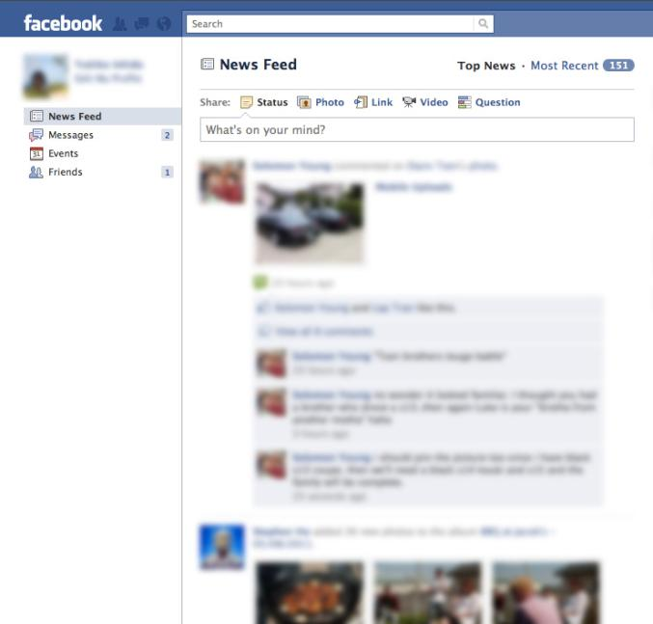
News feed:
Display 20 of the most recent posts by your friends.
This information is not coded into the page, instead the page retrieves what you need when you call it.

Slide 7
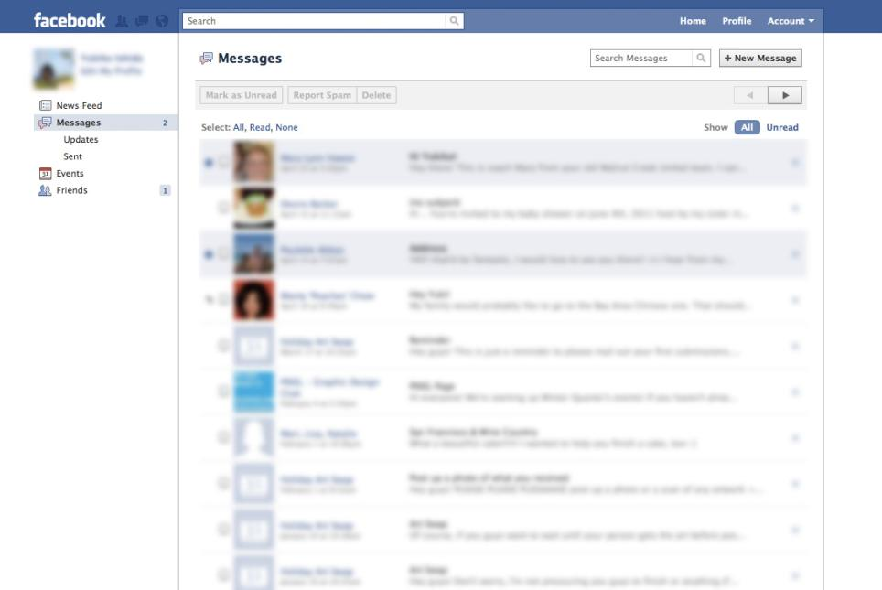
Messages:
The system decides what to display and what not to display. In this case, it displays messages sent to you.
(Don’t show news feed, wall posts, like/dislike, profile info, and other info not-relevant to this section)

Slide 8
Wordpress
Freeform CMS
You decide how to display content
You create the look and the feel
You can add content, form, and functionality
Some Content Managers already built in
Lots of plugins
You host it
Works for any type of content
Portfolio
Restaurant
Blog
Store

Slide 9
Wordpress as a Freeform CMS
Wordpress themes are templates you use to layout and design your site.
Many ways to get themes
Create your own theme (written in PHP)
Use a freely available theme
Modify a freely available theme
Buy a theme
Themes take ‘posts’ and display them, but a ‘post’ can be anything.
Class
Blog post
Food menu item
Portfolio piece

Slide 10
You don’t have to write a page for everything
The beauty of a CMS:
You don’t have to create every page by hand
You often only have ~6 pages that can appear to be hundreds
Home
Single display
Multiple display (will be used for search results too)
Category page
Blank Page
404
Pages change based on what the user is looking for.

Slide 11
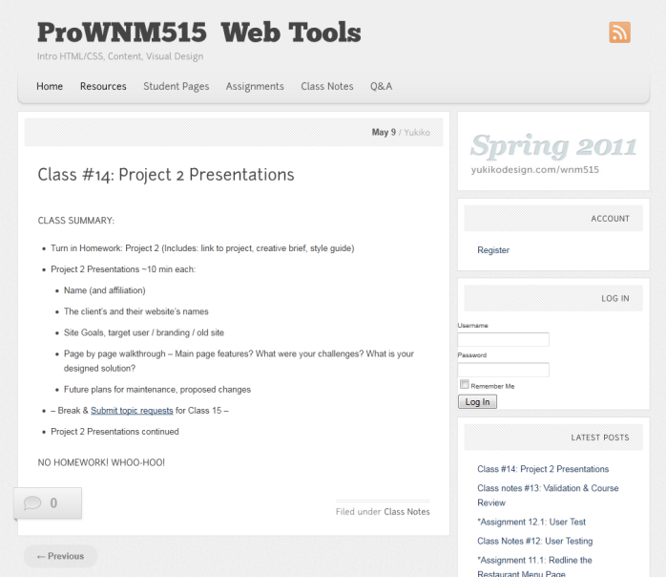
Examples
The course site for this … course.

Slide 12
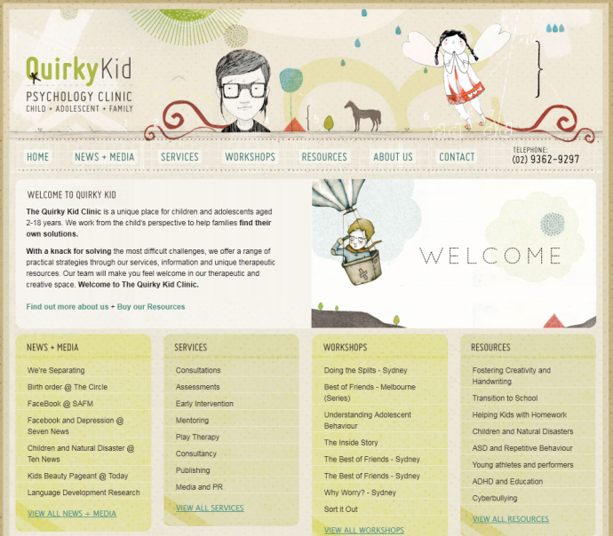
Examples
Quirky Kid

Slide 13
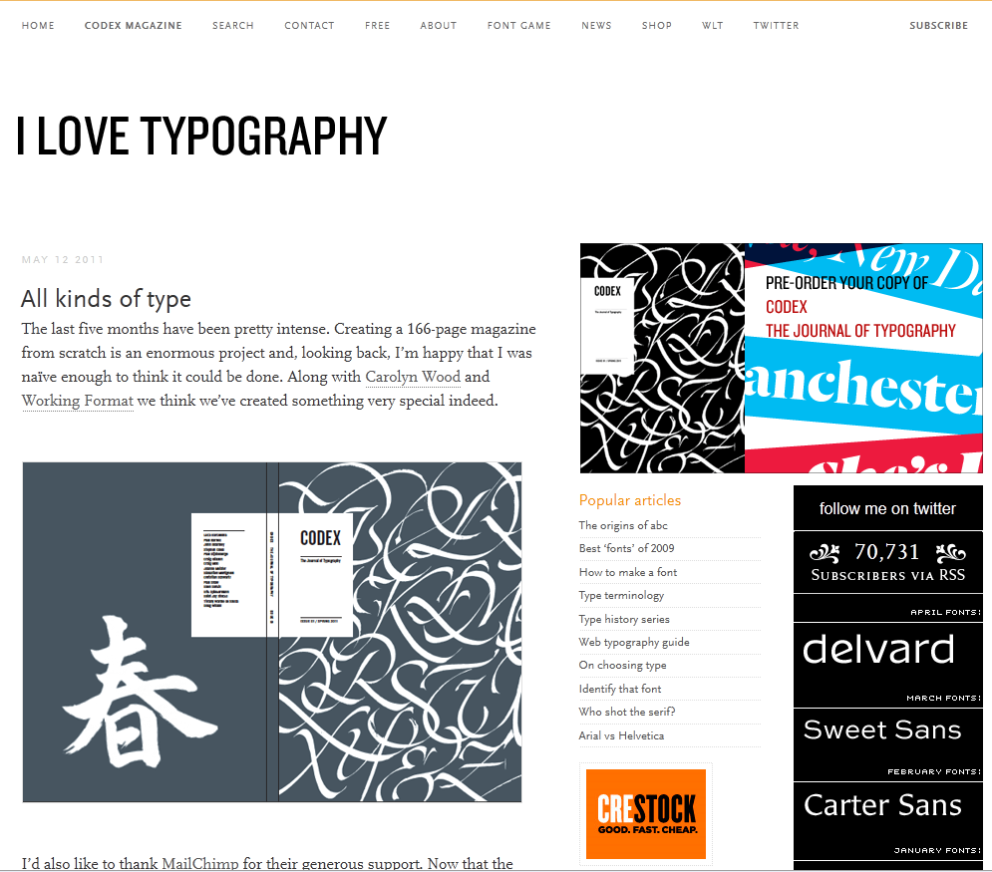
Examples
I Love Typography

Slide 14
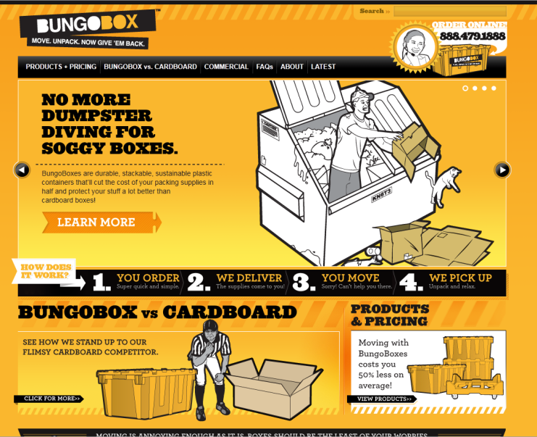
Examples
Bungobox

Slide 15
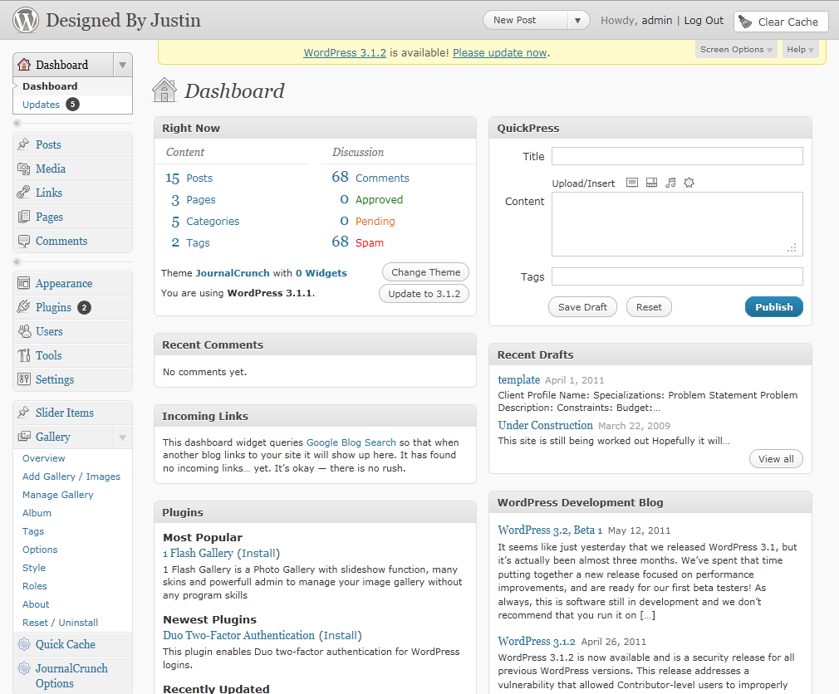
Admin Panel Example
Admin Panel

Slide 16
Squarespace
Is a code-free CMS
Allows you edit your CSS styles without writing the code
Allows you to edit your layout style using sliders
Not free
Hosted by them (you cannot host this yourself)
You get a ~.squarespace.com address by default, you can use your own domain name if you already have one.

Slide 17
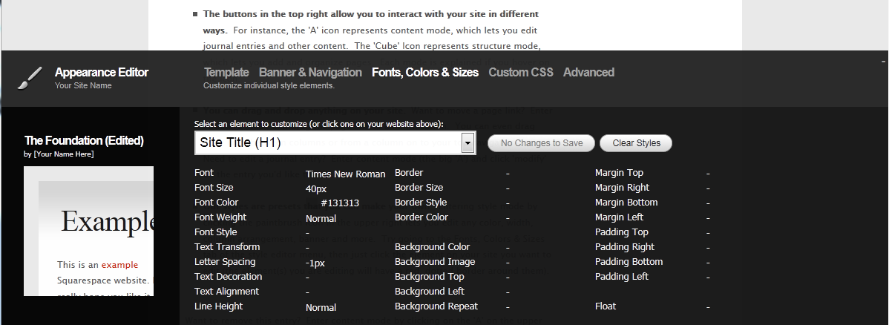
Square Space Admin Example

Slide 18
Server Side Languages (server side scripting)
Code that is run on your web server, not on the clients computer. This code can act as a connection between your web server (database, templates) and your user’s browser.
Examples
Java (not javascript)
PHP
Perl, Python, .net, ASP, Ruby on Rails.

Slide 19

Java
Is not Javascript (more details later)
High level, difficult language, like ‘C’.
Handles the data on the server.
Always running.
Can do difficult computations constantly, for example:
Generating live statistics (from just about any source)
Perform searches (think Google size search)
Text recognition

Slide 20
PHP
Is also not Javascript
You make the .php files public and they turn into the HTML page you want people to see.
Because of the per page style, it is often used for templates
You can use it to include parts of your page
Header.php
Footer.php
Navigation.php
Your PHP application is not always running, only runs when the .php page is called (run on request).

Slide 21
The other server side languages
Examples: Perl, Python, .net, ASP, Ruby on Rails
Each have their own strengths and weaknesses
You’ll only want to use them if you feel you need to
PHP will suffice for most cases

Slide 22
Client side languages
This does include javascript
This is run on the user’s browser.
Can actively manipulate the page without it reloading or a server connection
Can request more information from the server separately from the page.

Slide 23
Javascript
Part of the core HTML standard. It exists to be part of the web.
Can create custom interaction with HTML that CSS does not provide
Has easy-to-use libraries, including jQuery, DOJO, Yahoo (YUI), etc

Slide 24
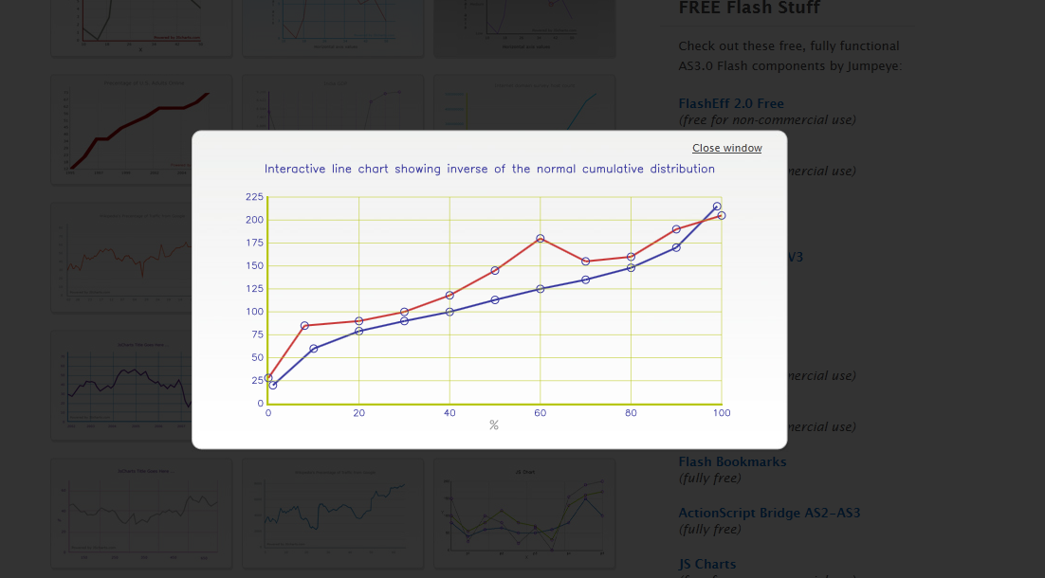
Examples: JSChart

Slide 25
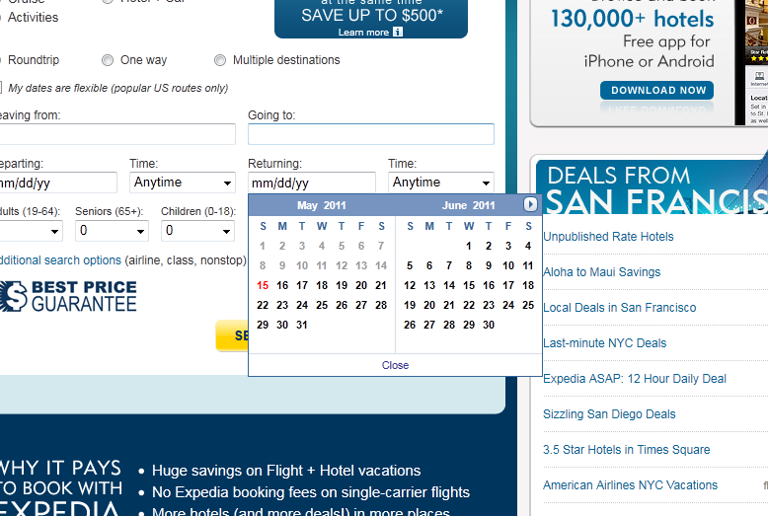
Example: Expedia popout calendar

Slide 26
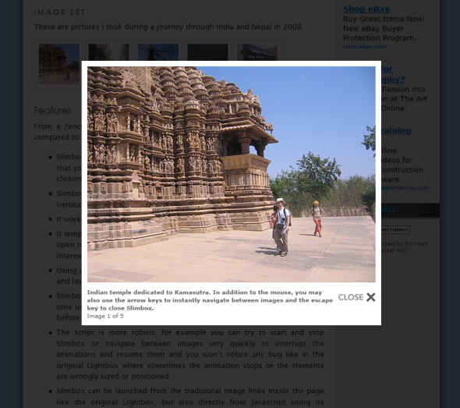
Example:Slimbox

Slide 27
Flash
Not part of the HTML standard
Uses a plugin from Adobe
Run on the clients browser (client side)
Two big uses for Flash:
Playing Media (Video, Audio)
Playing Highly interactive games (Kongregate, Armor games)

Slide 28
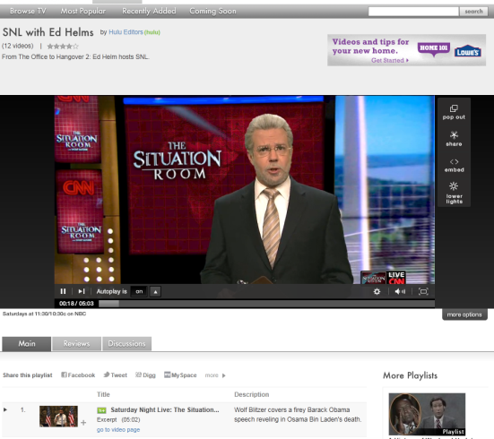
Example: Hulu.com
Uses Flash instead of the new HTML 5 Video tag.
HTML 5 does not have copy protection, but Flash does.

Slide 29
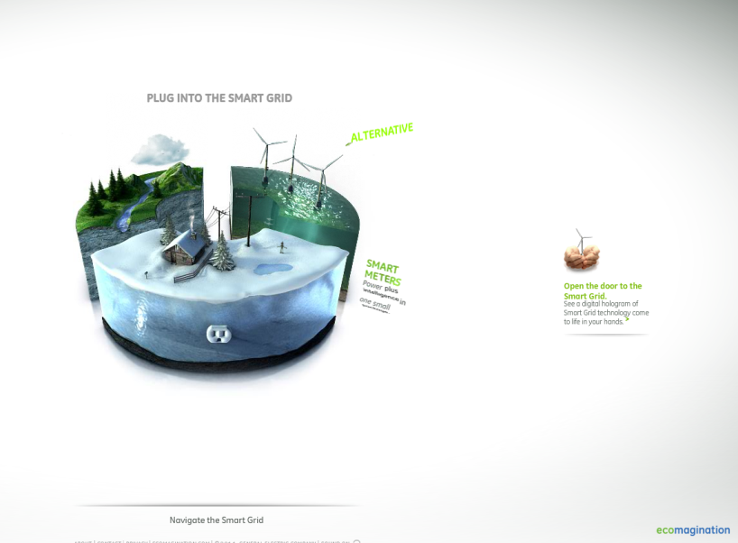
Example: GE Smartgrid
Flash allows for more complicated animations
Can have non-rectangular buttons
Can track and respond to the mouse cursor.
Can access web cams. Can use these for augmented reality apps.

Slide 30
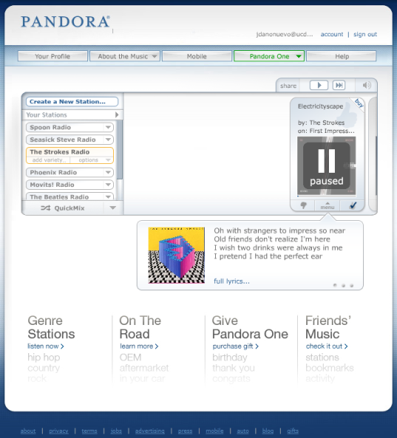
Example: Pandora
Uses flash to stream custom radio to listeners
Can fetch new tracks on the fly and record like/dislikes without having to reload the page.
Uses a highly customized interface.

Slide 31
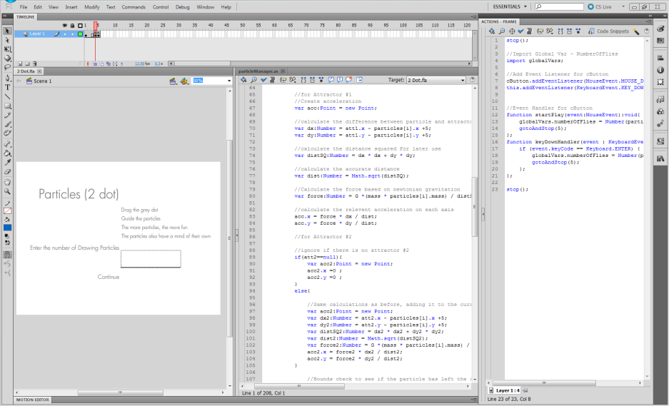
Building with Flash

Slide 32
Questions & Comments?

